Slide 1

Smart Timesheet Management System
Team - F

Slide 2
Table of Contents
01
02
04
05
Introduction
Software Requirements and Database
Architecture
Conclusion
03
06
Results
Language requirements

Slide 3
Introduction
Timesheet

Slide 4
Paper based Timesheet
Web based Timesheet
Most timesheets are now written on paper. Paper-based timesheets may be a stumbling block for businesses seeking to increase efficiency.
Paper timesheets take up a lot of office space, which costs money and takes time to process and submit.
The paper-based time-sheet might be untrustworthy at times.
A web-based timesheet saves time and is quite trustworthy.
Nobody may claim to have worked more than a certain number of hours.
The total time work computation is correct when using a web-based timesheet.
Ensure increased productivity, time savings, and cost savings

Slide 5
Objective
Problem statement
To create a smart timesheet and client management system that will assist the client in managing and viewing data in a more efficient manner.
To update the client timesheet to reflect changes made to the employee timesheet.
To create reasoning that reflects the most recent updates.
To use SQL Server, HTML, and other tools and technologies to accomplish the logic.
The client couldn't view the prior data since it had been overwritten by the newly entered data.
there was no information available about the most recent time and date on which the employee updated the timesheet.

Slide 6

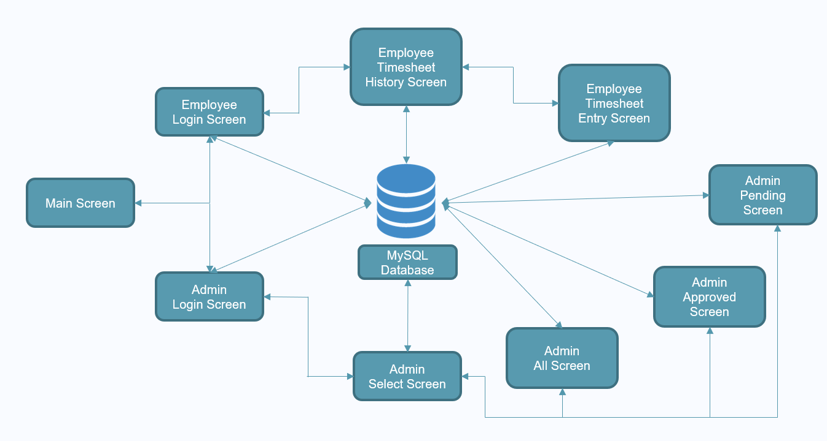
Architecture

Slide 7
Language Requirements

Slide 8

HTML
Most basic building block of the web. It defines the meaning and structure of web content
Describes the structure of a web page semantically and originally included cues for the appearance of the document.
Applications
Webpage development
Internet Navigation
Responsive UI
Offline support
Game development

Slide 9
CSS
Style sheet language used for describing the presentation of a document written in a markup language such as HTML.
CSS is a cornerstone technology of the World Wide Web, alongside HTML and JavaScript.
Designed to enable the separation of presentation and content, including layout, colors, and fonts.
Applications
CSS saves time
Pages load faster
Easy maintenance
Superior styles to HTML
Multiple Device Compatibility
Global web standards

Slide 10
Python
Python is an interpreted, object-oriented, high-level programming language with dynamic semantics
Its high-level built in data structures, combined with dynamic typing and dynamic binding, make it very attractive for Rapid Application Development
Python is used for web development, AI, machine learning, operating systems, mobile application development, and video gamesBeginner-friendly because
Python supports modules and packages, which encourages program modularity and code reuse
The Python interpreter and the extensive standard library are available in source or binary form without charge for all major platforms, and can be freely distributed

Slide 11
Flask Library
Python-based web application framework.
Simple to understand and apply.
Beginner-friendly because
Lacks boilerplate code and dependencies, both of which can detract from an application's core role.
Comes with a debugger and a development server.
Jinja2 templates are used.
Complies with the WSGI 1.0 standard.
Has built-in support for unit testing.
Flask has a plethora of extensions that may be used to expand its capabilities.

Slide 12
Software Requirements and Database

Slide 13
Software Requirements
MySQL
Relational database management system (RDBMS) based on Structured Query Language (SQL) that is supported by Oracle (SQL).
Employs a client-server architecture
Available as a stand-alone software for usage in a client-server networked environment
Available for Linux, UNIX, and Windows, among other operating systems
Visual Studio Code
Lightweight but powerful source code editor from Microsoft that runs on desktop
Includes built-in support for JavaScript, TypeScript, and Node.js
Enables users to access one or more folders, which may subsequently be stored in workspaces for future use
Used to build repositories as well as perform push and pull requests.

Slide 14
Database
Database is a logically ordered collection of structured data kept in a computer system.
A database management system (DBMS) is generally in charge of a database.
A database system, which includes the data, the DBMS, and the applications that go with it, is referred to as a database system, or simply database.
SQL (Structured Query Language) is a programming language that allows you to access and manage databases.
SQL can run queries against a database, obtain data from a database, insert entries in a database, update records in a database, remove records from a database, and build new databases and tables.

Slide 15
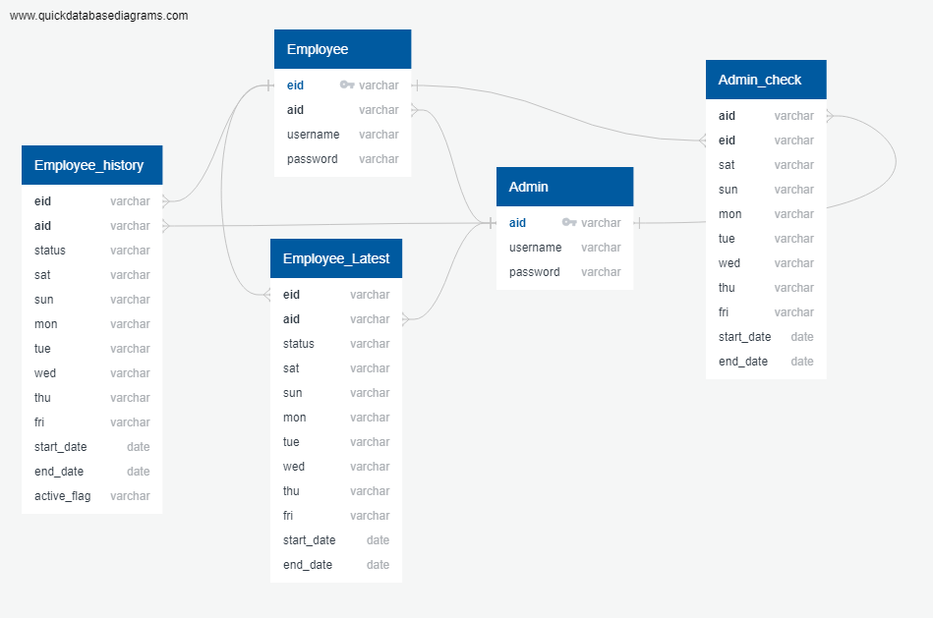
Schema

Slide 16
Results

Slide 17

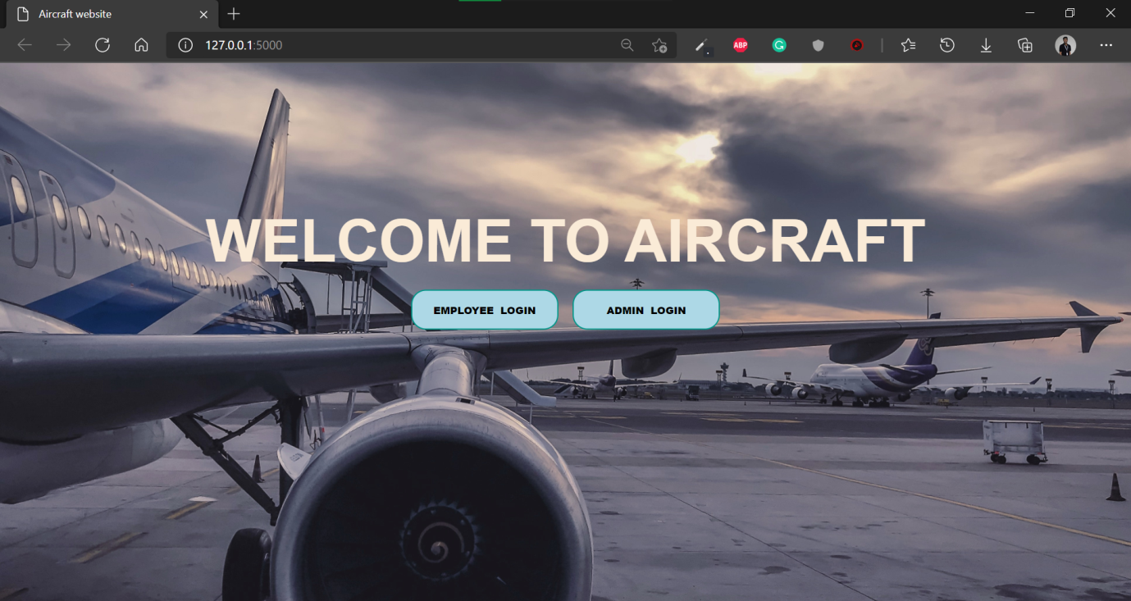
Main Screen

Slide 18
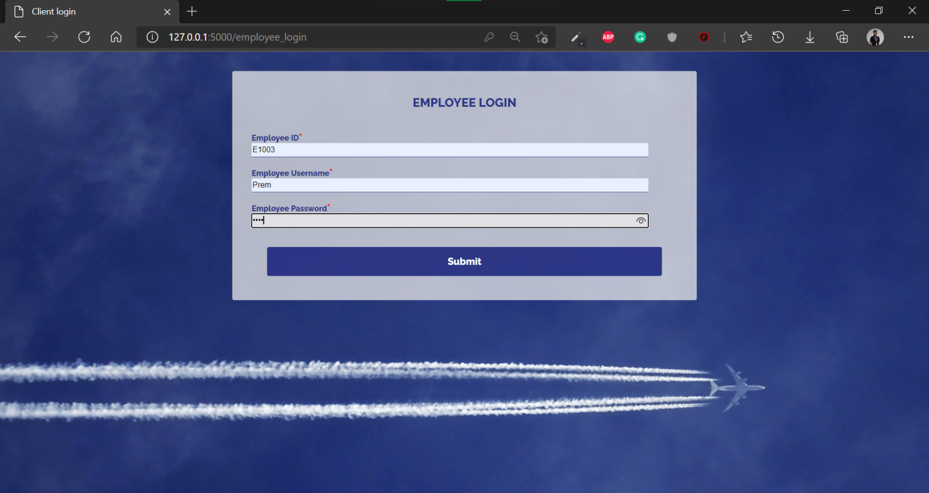

Employee Login Screen

Slide 19
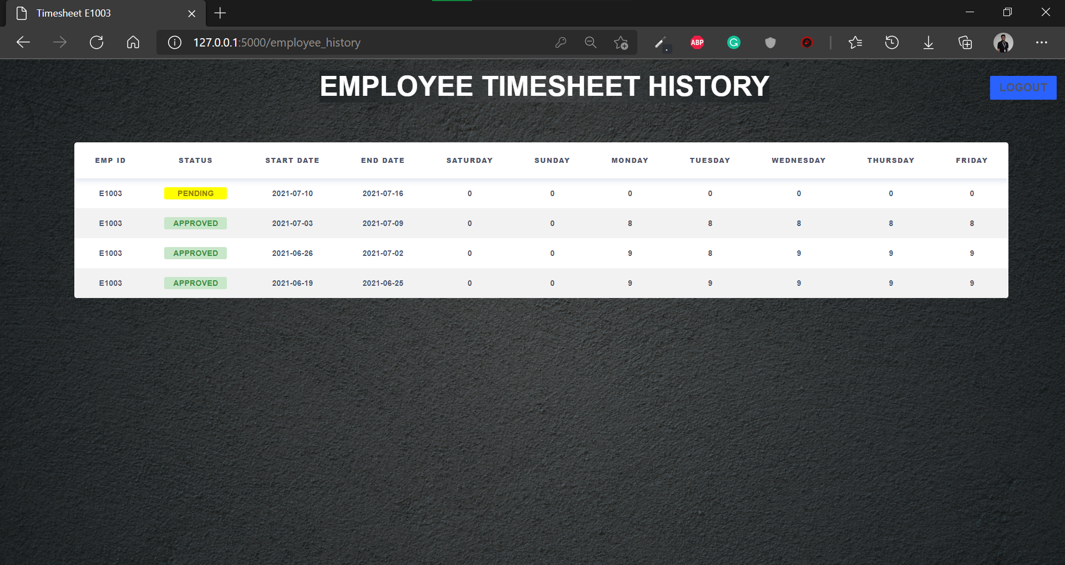
Employee Timesheet History Screen

Slide 20
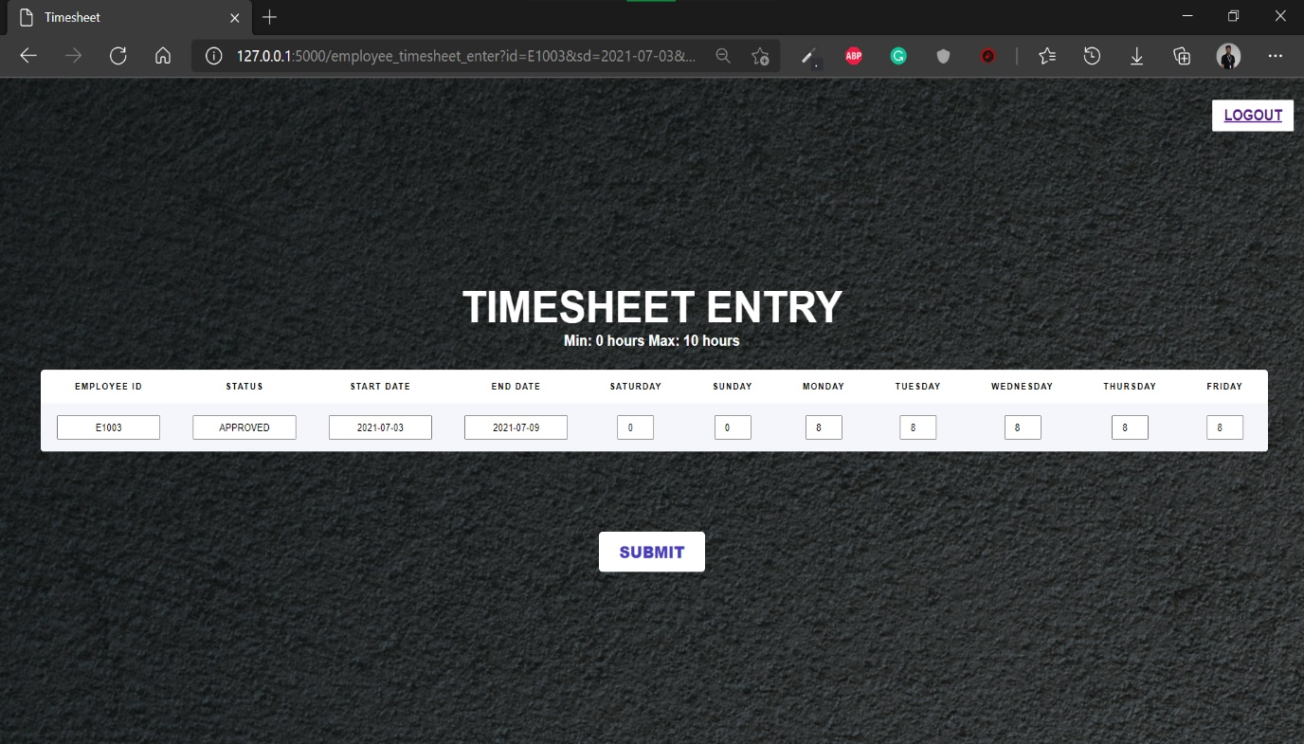
Employee Timesheet Entry Screen

Slide 21


Admin Login Screen

Slide 22
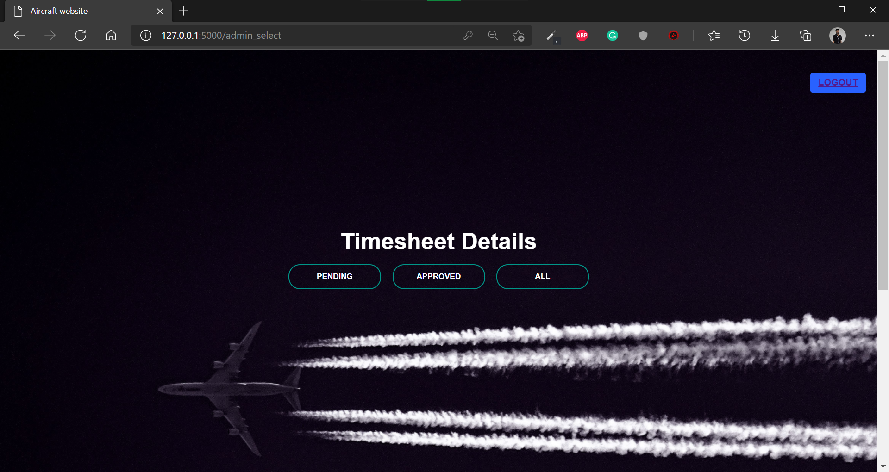
Admin Select Screen

Slide 23
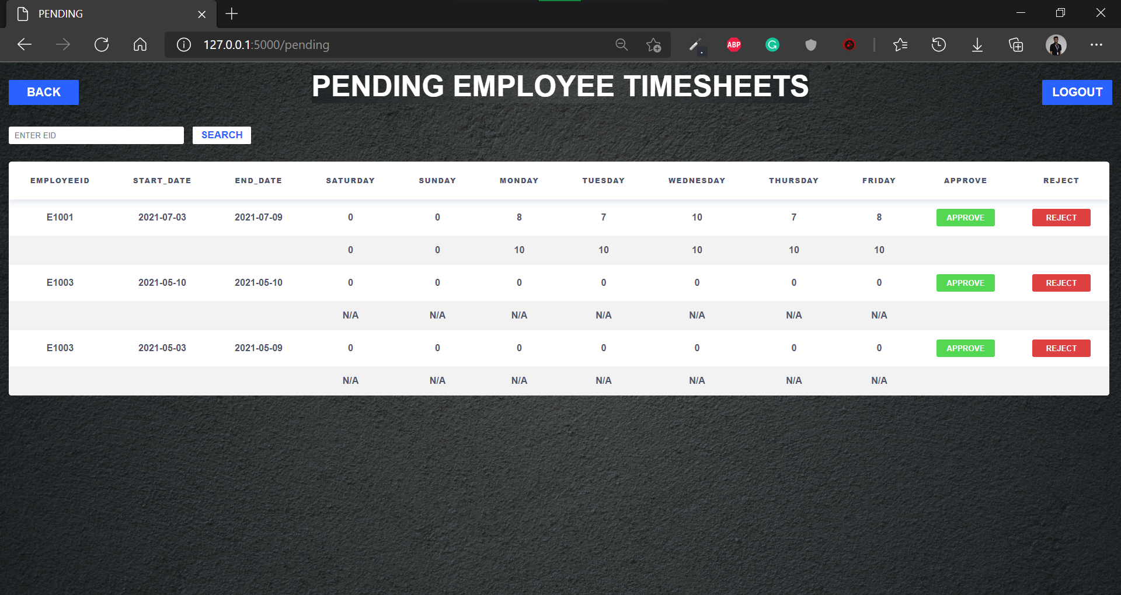

Admin Pending Screen

Slide 24
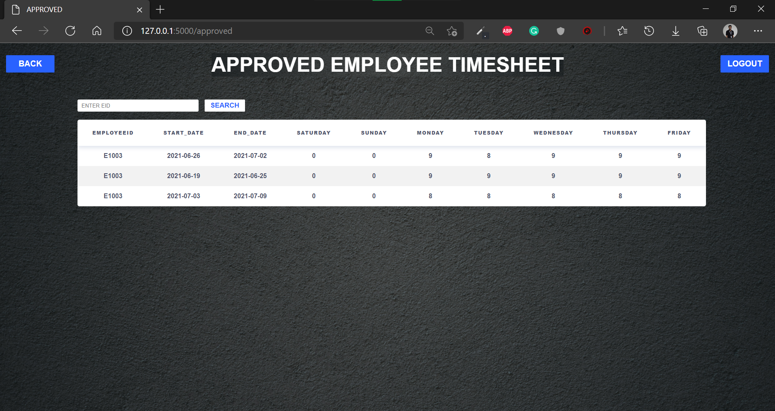

Admin Approved Screen

Slide 25
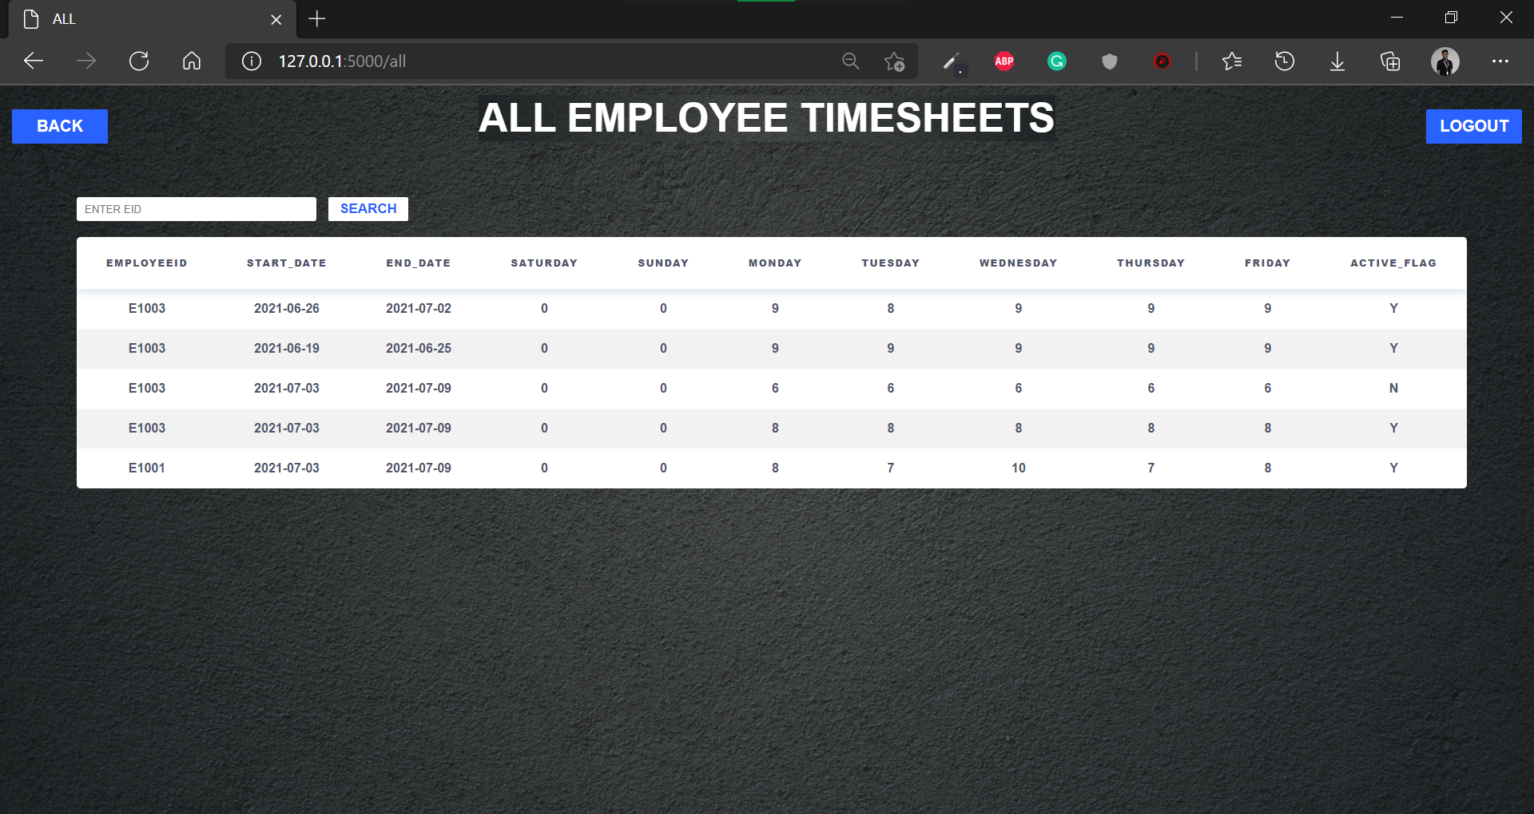
Admin All Screen

Slide 26

Conclusion
By using standard resources and tools, our visitors are able to view our web pages no matter what browser they use.
Our pages would load faster and we would also be able to maintain the pages we have created with ease.
We finished off by putting everything together and looking at how to leverage table relationships to query data across multiple tables, using an SQL.
Flask's framework is more easier to learn because it has less base code to implement a simple web-Application and is also performant and flexible.
We focused on both performance and user interface, as we believe both are a must for user satisfaction.

Slide 27





Team F
Prem Raj S
Team Lead
(Backend)
Abinaya K (Frontend)
Kanthimathi S
(Backend)
Preethi S
(Frontend)
Medha M
(Frontend)
Santhosh Kasirajan
(Frontend)

Slide 28
THANK YOU!!

Slide 30

Employee Timesheet History Screen
Employee Timesheet Entry Screen
Employee Login Screen
Admin
Pending Screen
Main Screen
MySQL Database
Admin
Login Screen
Admin
Approved Screen
Admin
All Screen
Admin
Select Screen

